Slide 1
LASSI PDR: Software Architecture
Nathaniel D. Sizemore (nsizemor@nrao.edu)
September 11, 2019

Slide 2
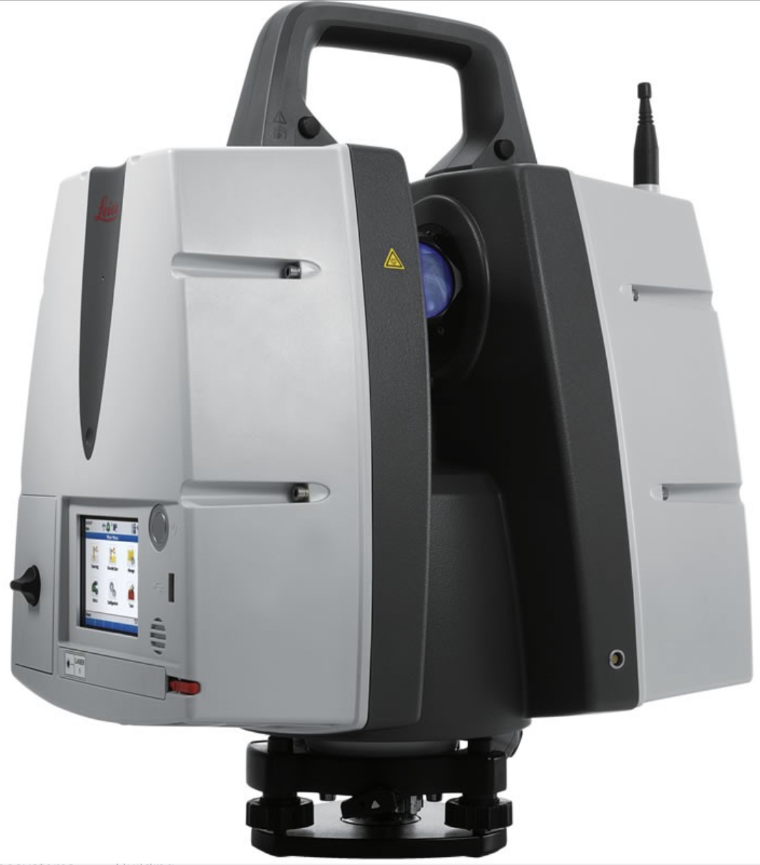
LASSI

Slide 3
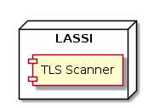
LASSI

Slide 4
Overview
Methodology
Requirements
Current Progress
LASSI Timing
Questions

Slide 5
Methodology
Attribute-Driven Design (ADD)
Developed by Software Engineering Institute
The end result: a collection of “views” that communicate the design of the system to whoever needs to know
Views can be at different scales for different needs: from class definitions up to high level context diagrams

Slide 6
Requirements
Functional requirements
Quality requirements
Interoperability
Accuracy
Performance
Constraints

Slide 7
Greenfield Development

Slide 8
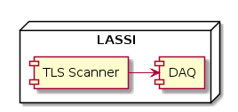
Accuracy

Slide 9
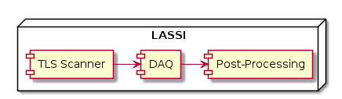
Accuracy, Performance

Slide 10
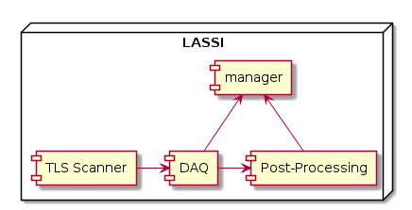
Interoperability

Slide 11
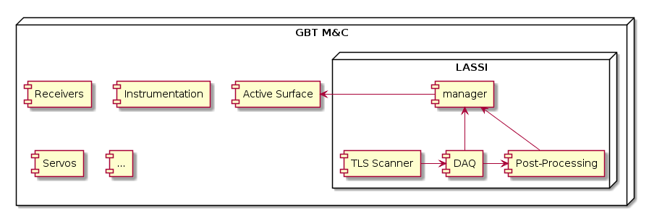
Interoperability

Slide 12
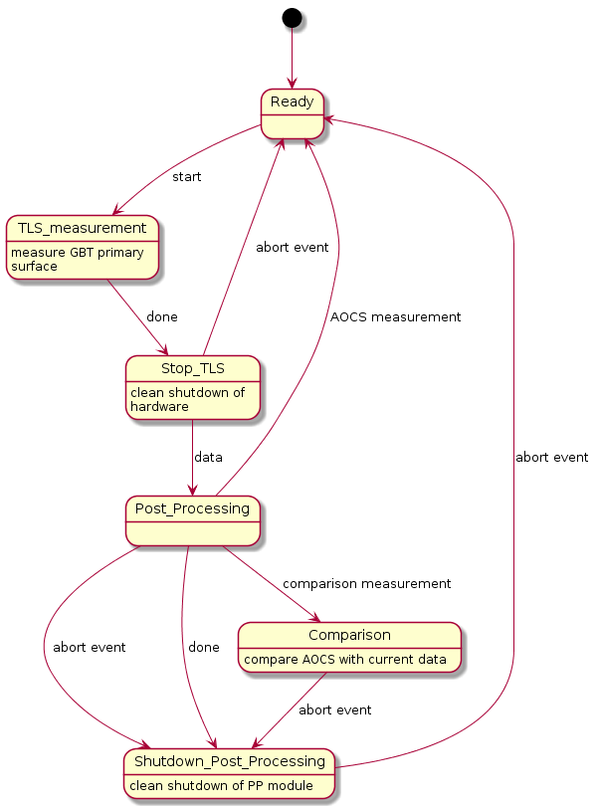
View —State

Slide 13
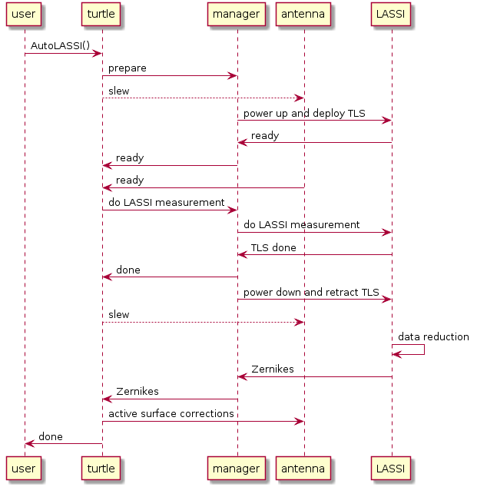
View — Sequence

Slide 14
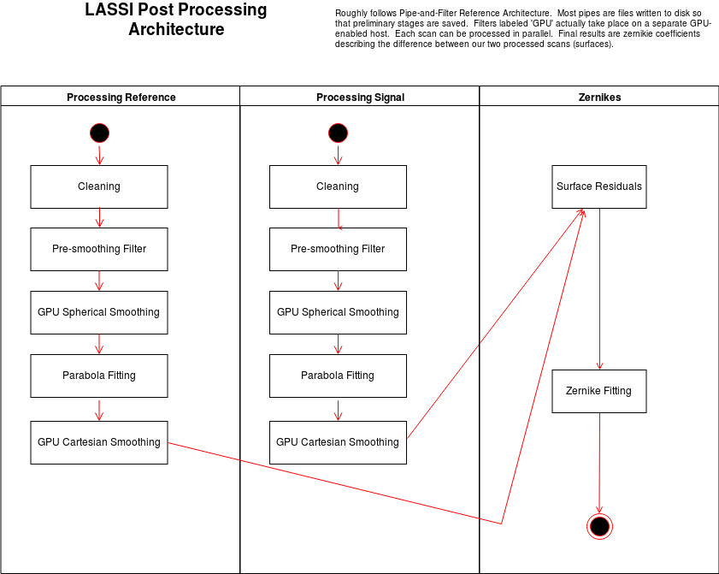
View — Post-Processing

Slide 15
Current Progress
LASSI DAQ
functional, and currently in use
Post-Processing
prototype code, but already working as intended
Manager
TBD — will be similar to many existing managers

Slide 16
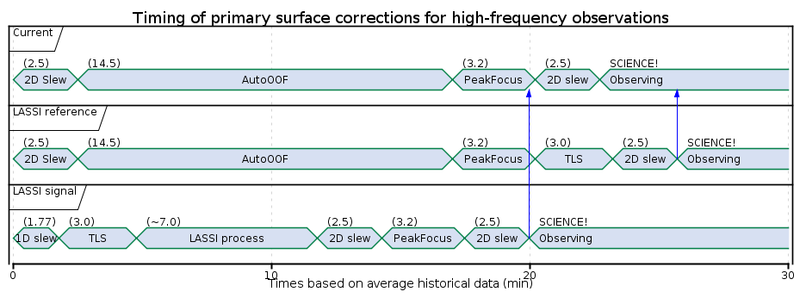
LASSI Timing

Slide 17

Questions?

